Slide 1
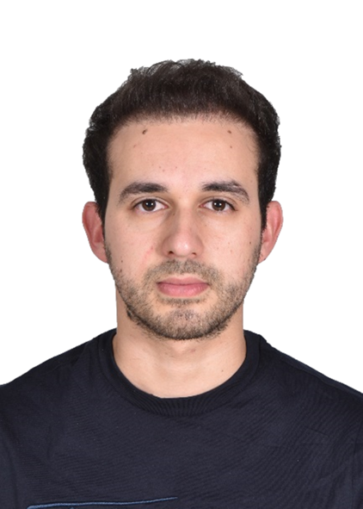




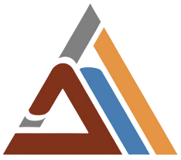

PORTOFLIO
M’hassni Mohamed

Slide 2
Table of content
Who am I?
A Family Business Success Story
Key achievements
Failures and lessons learned
Conclusion

Slide 3
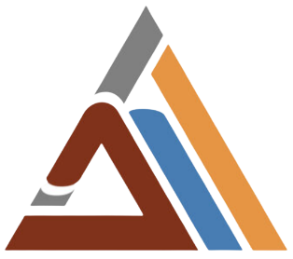
Introduction
Who am I?
M'hassni Mohamed's passion for automation is evident in his work helping companies improve their service quality and profitability by automating their business processes. With varied experience in systems architecture, geomatics, digital marketing, and many other areas, M'hassni brings a unique perspective to every project he undertakes
GIS and Cloud engineer gradueted from EHTP
Microsoft Certified Azure Solutions Architect Expert

Slide 4
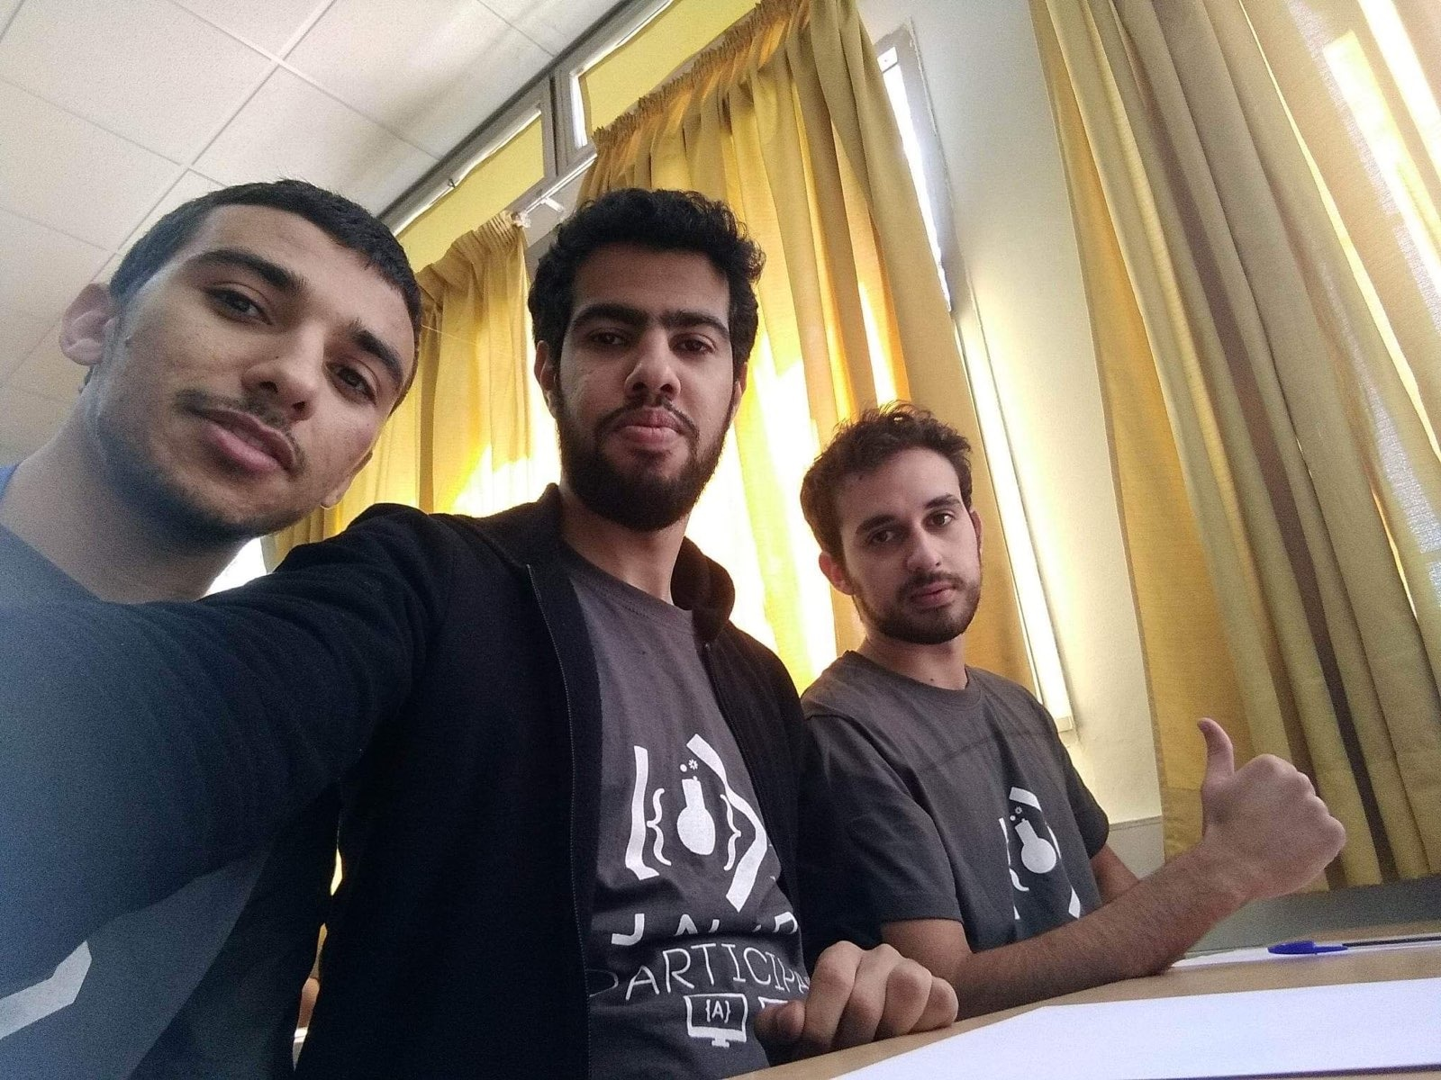
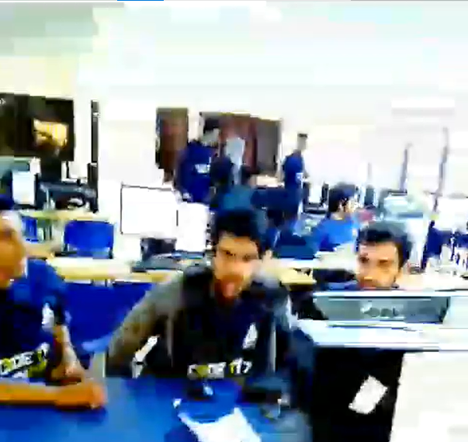
A Family Business Success Story
Early Involvement and Passion
First topography experience at age 12
Started learning programming languages (C, C++, JavaScript, vba, …) at 13
Attended a highly selective preparatory program (Math, Physics, Computer Science)
Participated in various code problem-solving competitions to challenge myself
National podium winner in ICPC the most prestigious programming competitions in the world

Slide 5
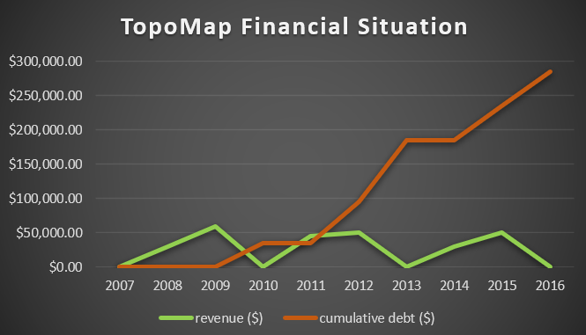
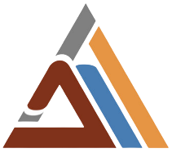
A Family Business Success Story
In the meantime
Family business: TopoMap, founded in 2007
Specialization: B2B Topography and geomatics
Financial struggle: Deficit for 10 years, cumulative debt of $300,000
At 2016 Decided to study Topography and Computer Science at EHTP, the most prestigious school in the country

Slide 6
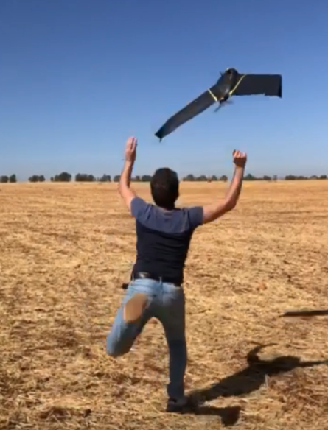
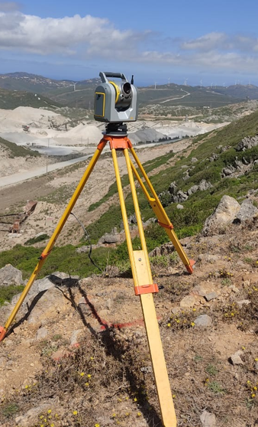
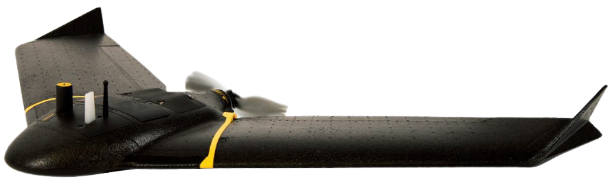
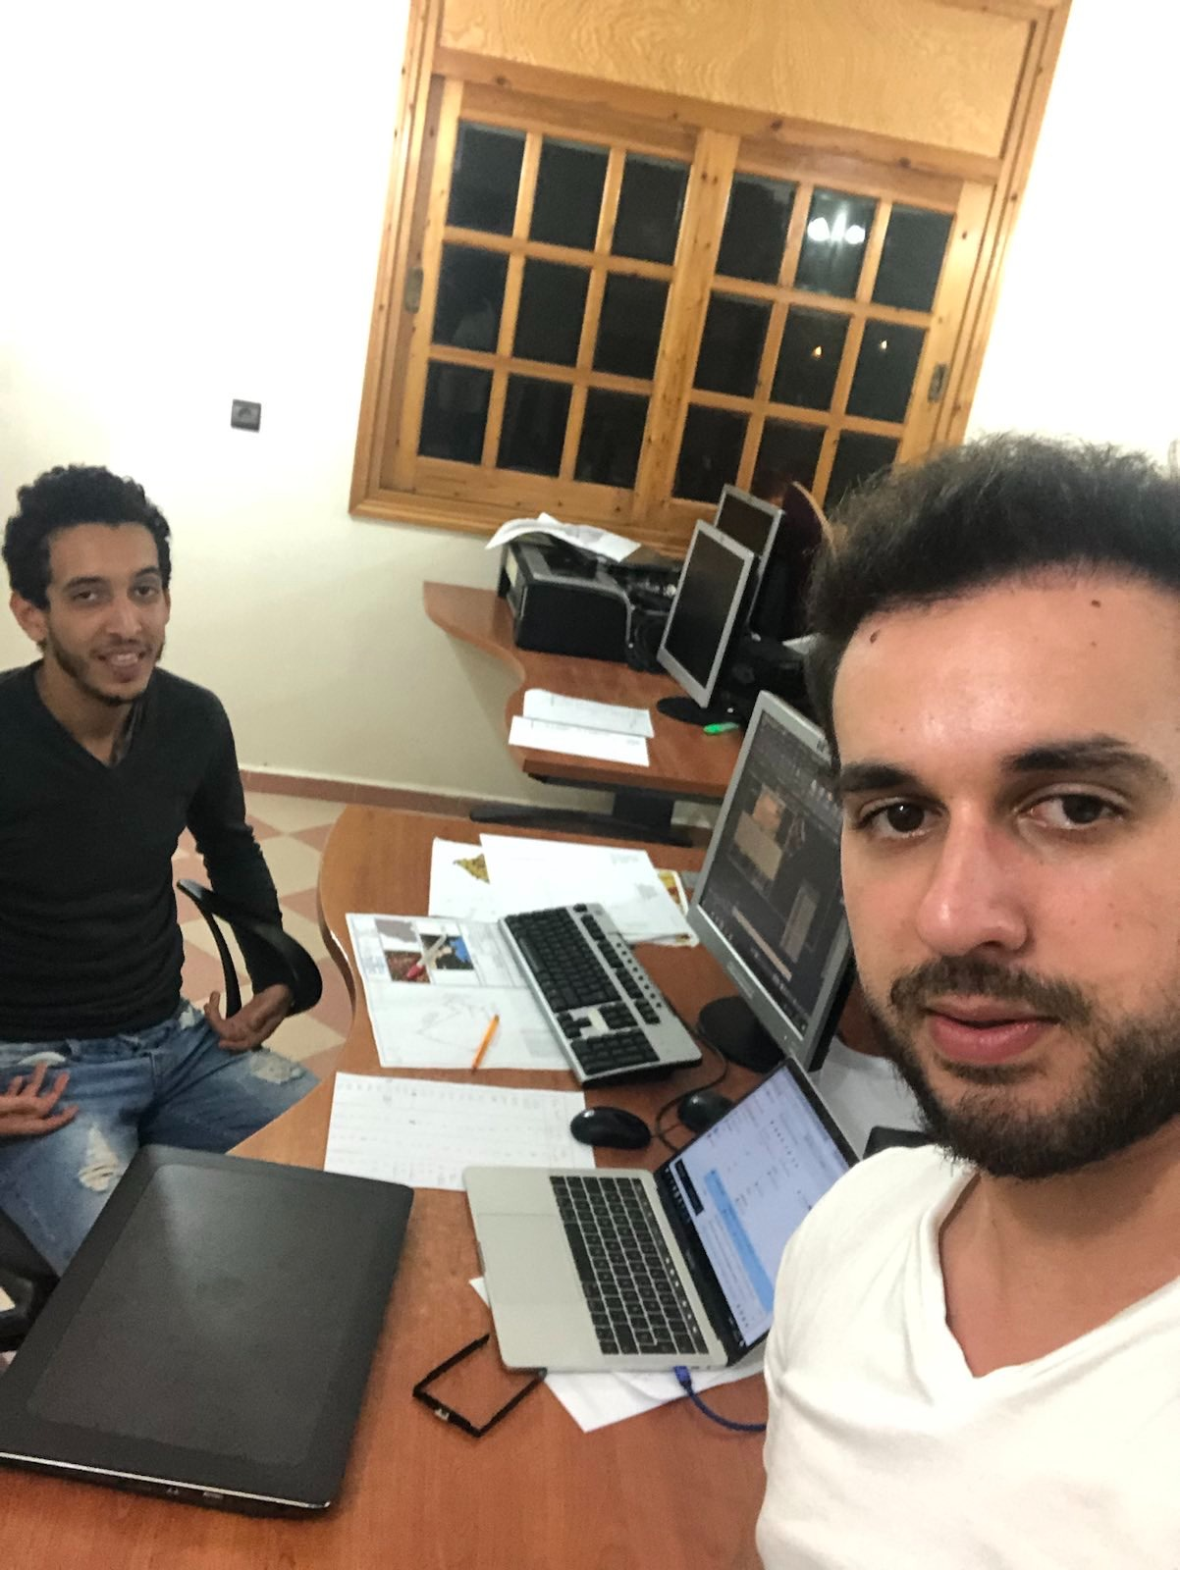
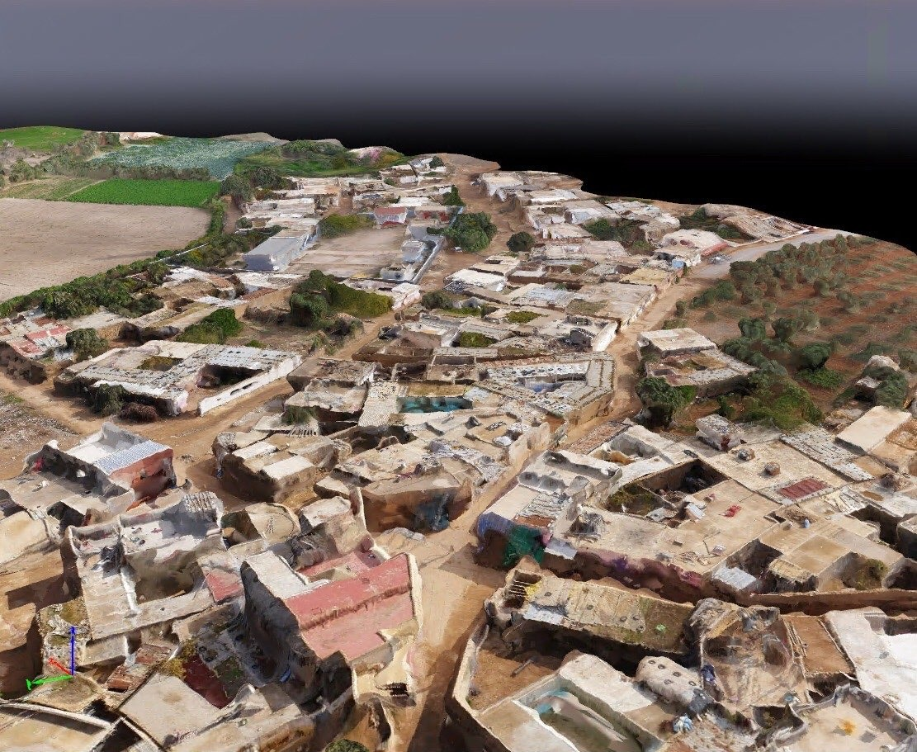
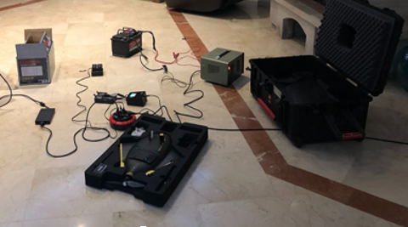
A Family Business Success Story
Implementing Technology in TopoMap
Introduced technological solutions to optimize workflow :
Business process optimization
cloud-based system infrastructure
infrastructure networking
staff training to new GIS technologies ( topographical drones , ArcGIS , 3D models … )
Developed Tools for automating repetitive tasks
Developed TopoMap CadGIS a software extension to manage land title lifecycle according to Cadastral office standards

Slide 7
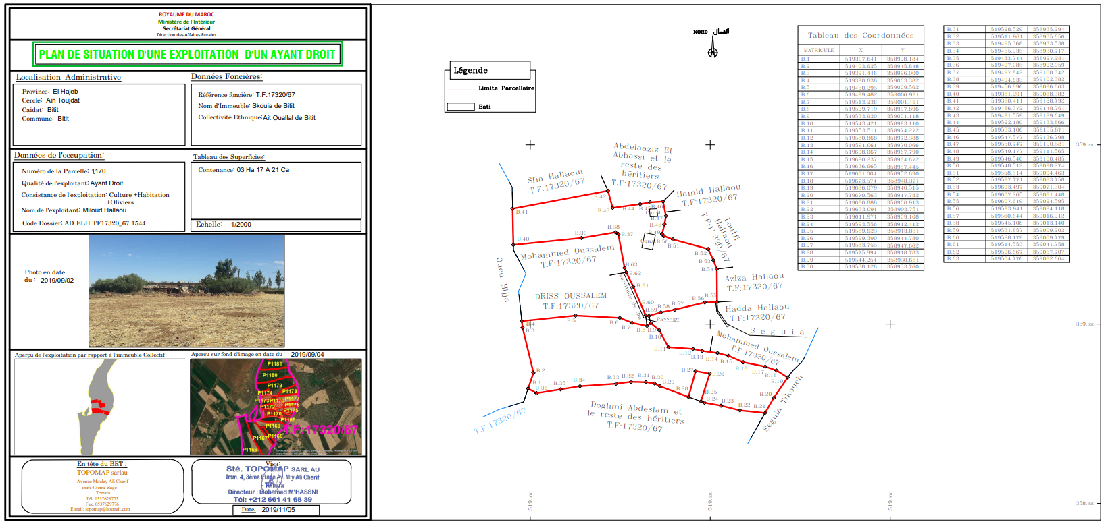
A Family Business Success Story
Taking a Leap of Faith
Company struggling, but bid on a large public contract
Required were 25 topography technicians for office work, but TopoMap had only 4 available
a 4-month deadline
fully automated drawing with TopoBot
Decided to develop TopoBot a solution to automate most of the plan-making process to meet the project

Slide 8
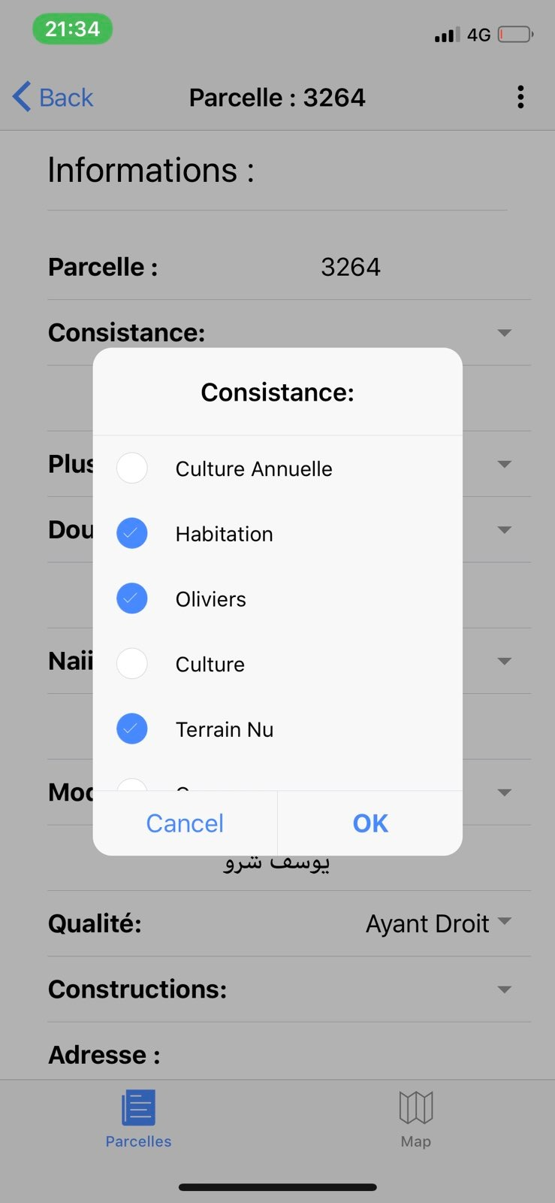
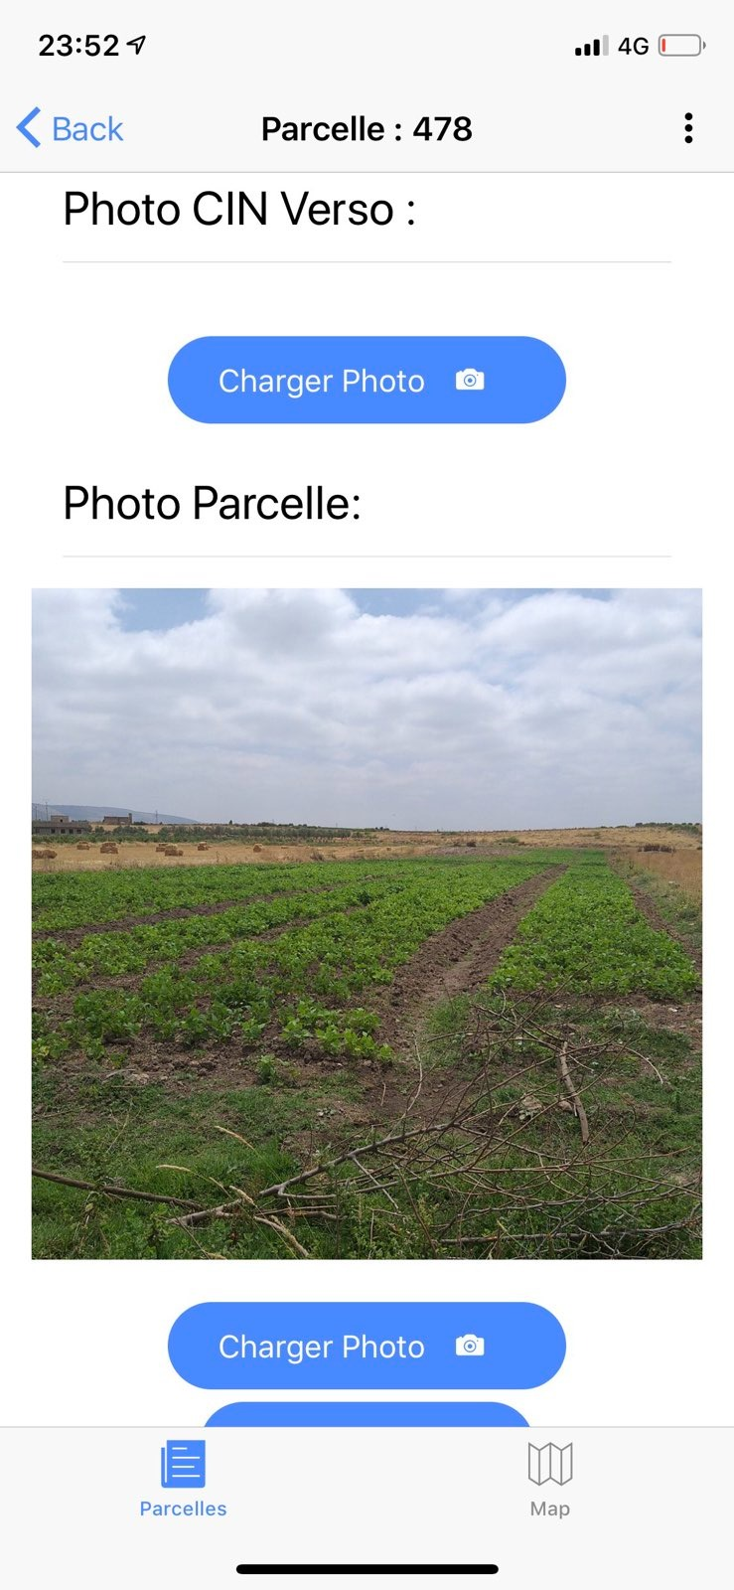
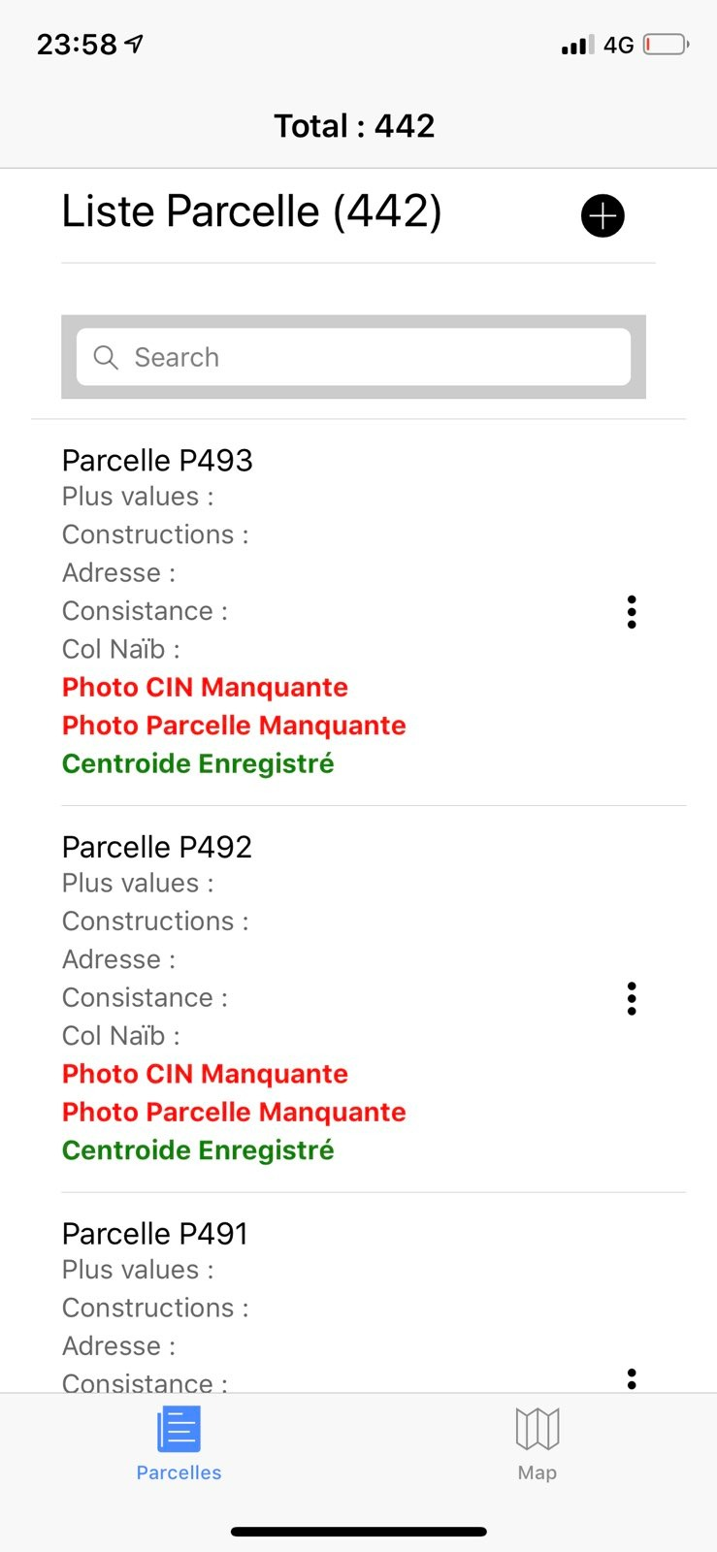
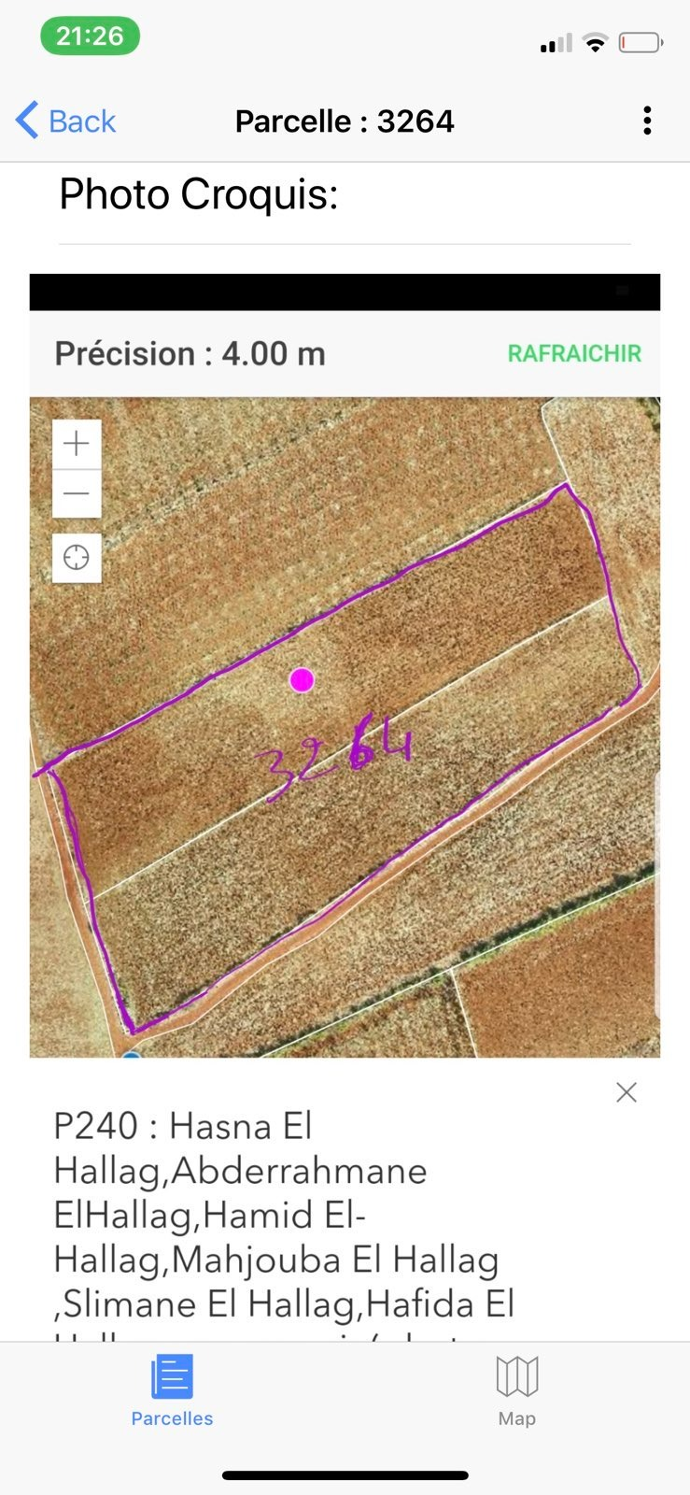
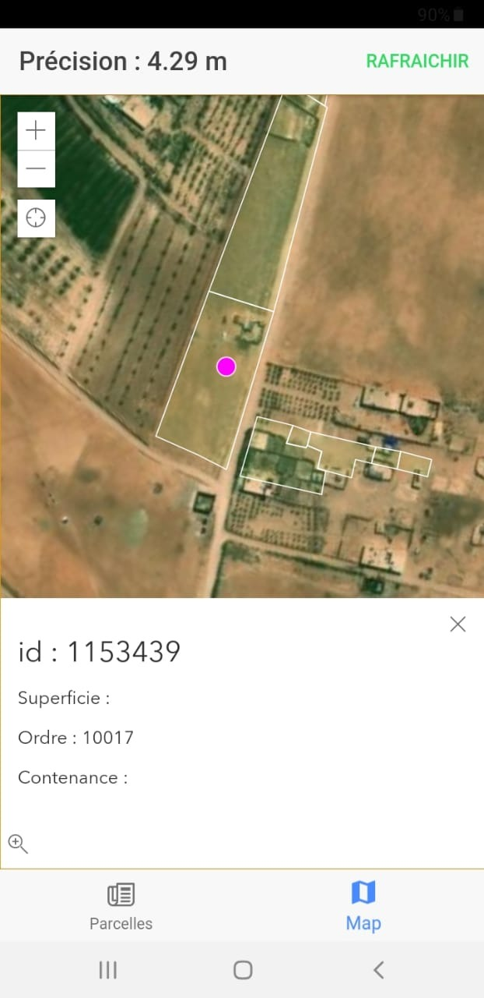
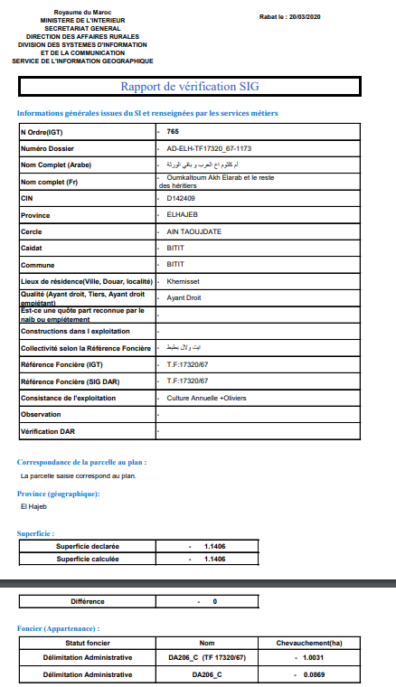
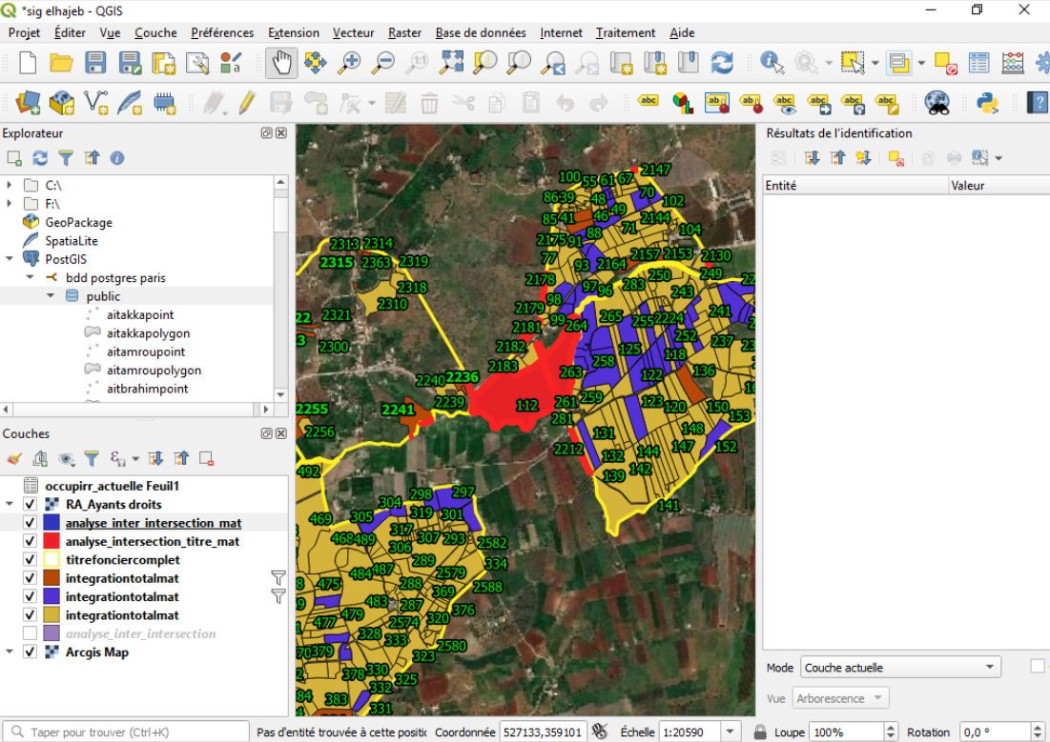
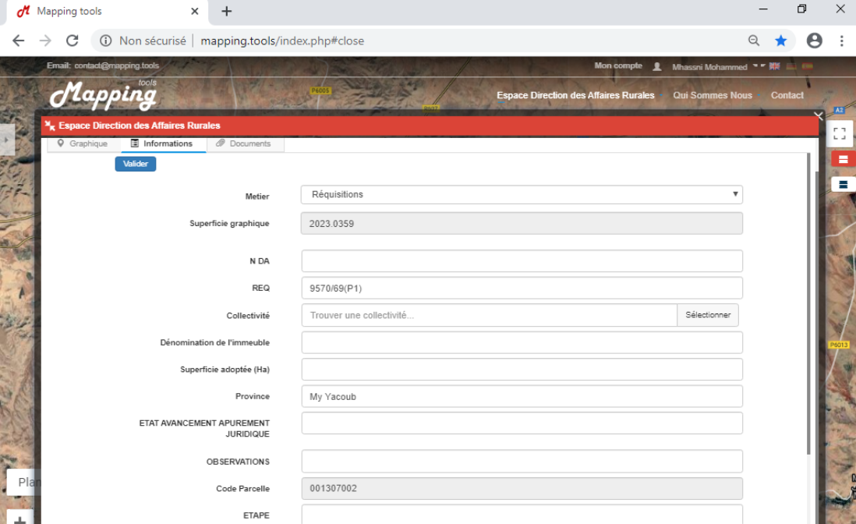
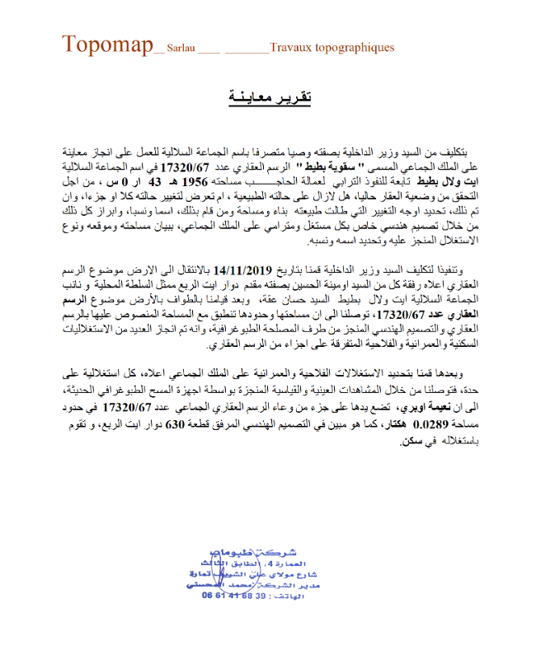
A Family Business Success Story
TopoBot Overview
TopoBot Survey Mobile App
Mobile solution for data acquisition
AutoCAD extension for automated drawing
Automatic report and parcel sheet generation
Automated geometric data correction
Centralized database for real-time data
Bot script to integrate data throughout the ministry platform
Cartographic server for drone images
TopoBot Survey Desktop

Slide 9
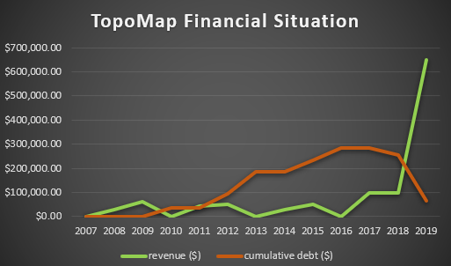
A Family Business Success Story
Project Success
Error rate reduced from 60-70% to 1-2%
Plan generation time decreased from 2 hours to 5 minutes
7x increase in revenue compared to the previous years
Market leader in topography survey sector (short-term)
All company debt fully repaid

Slide 10
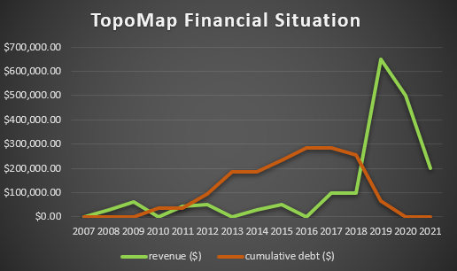
A Family Business Success Story
Overcoming Challenges
The COVID-19 pandemic resulted in a decrease in topographical survey business
In 2021, secured a special public contract for topographic quarry plans with specific constraints that required research work
Special project demands led to developing TopoBot Quarries and related research work

Slide 11
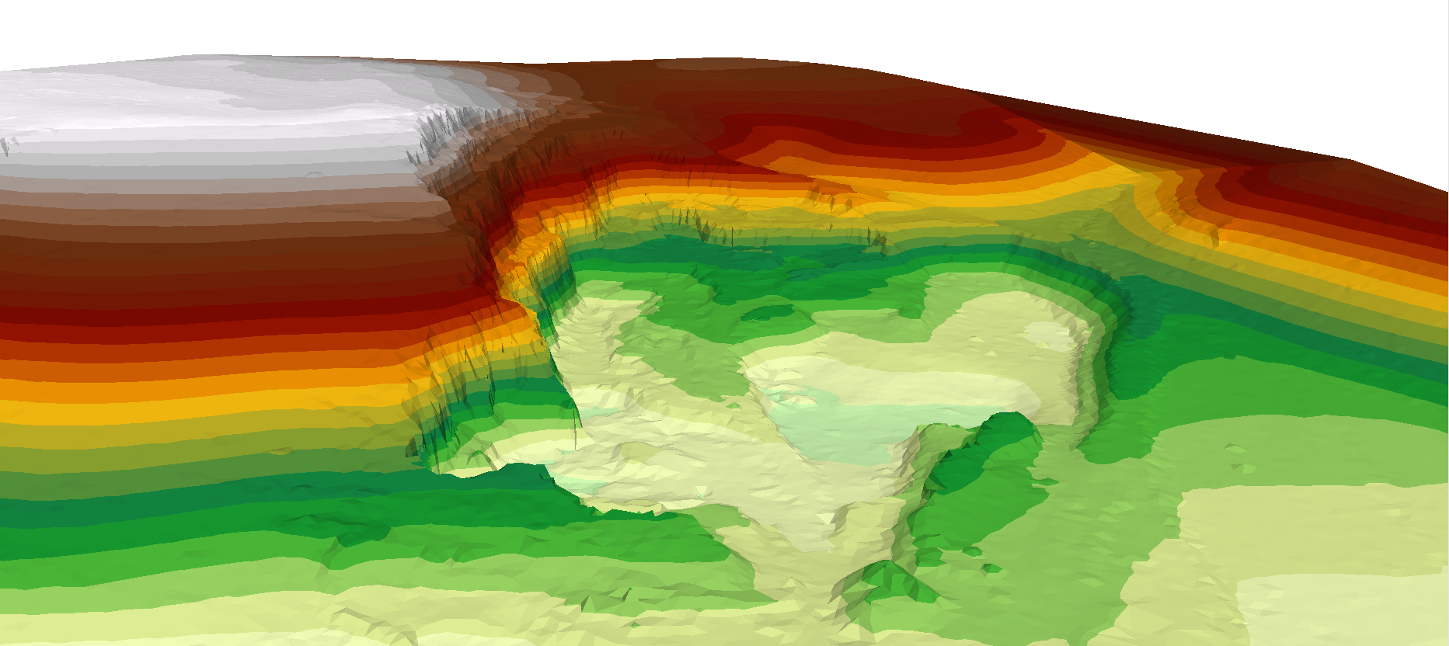
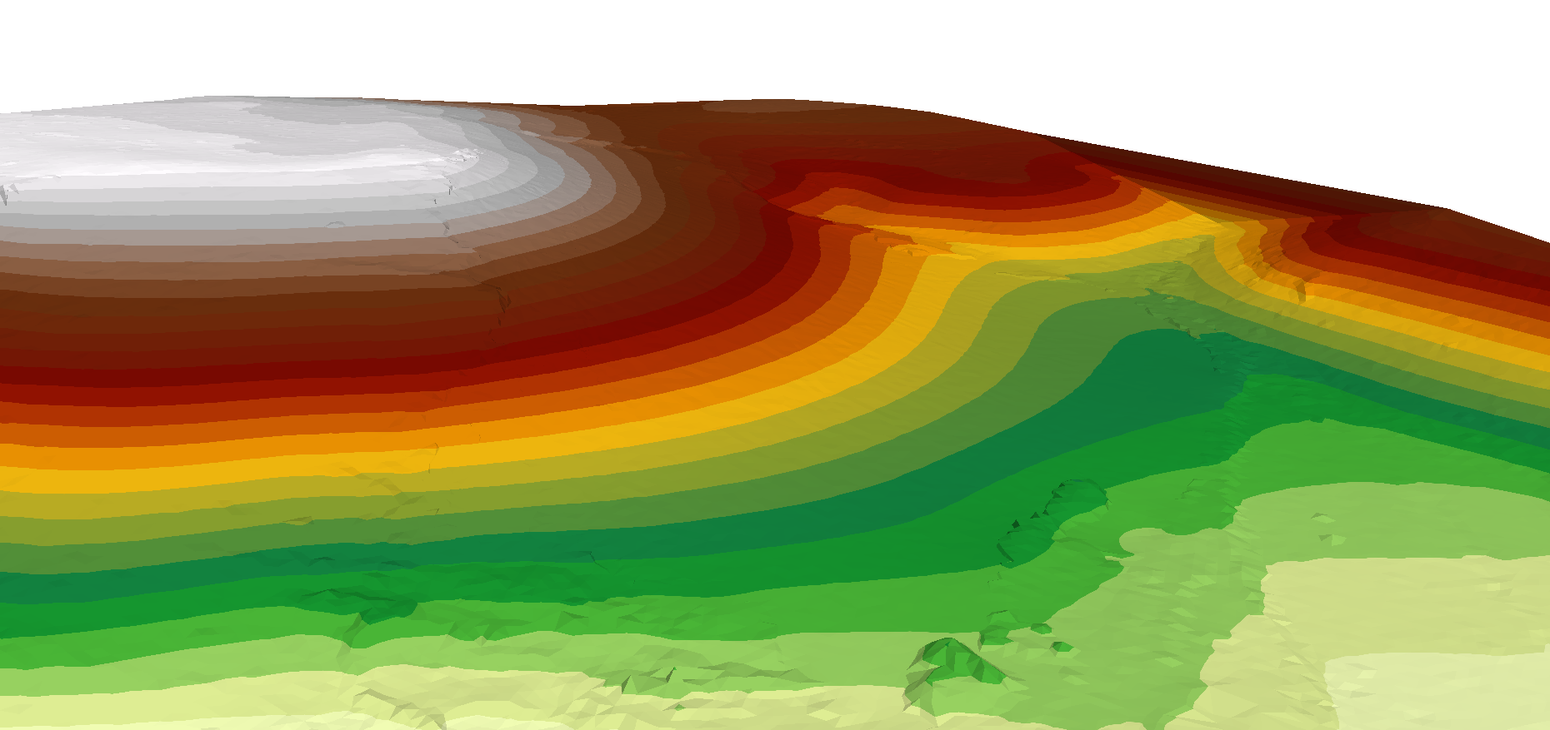
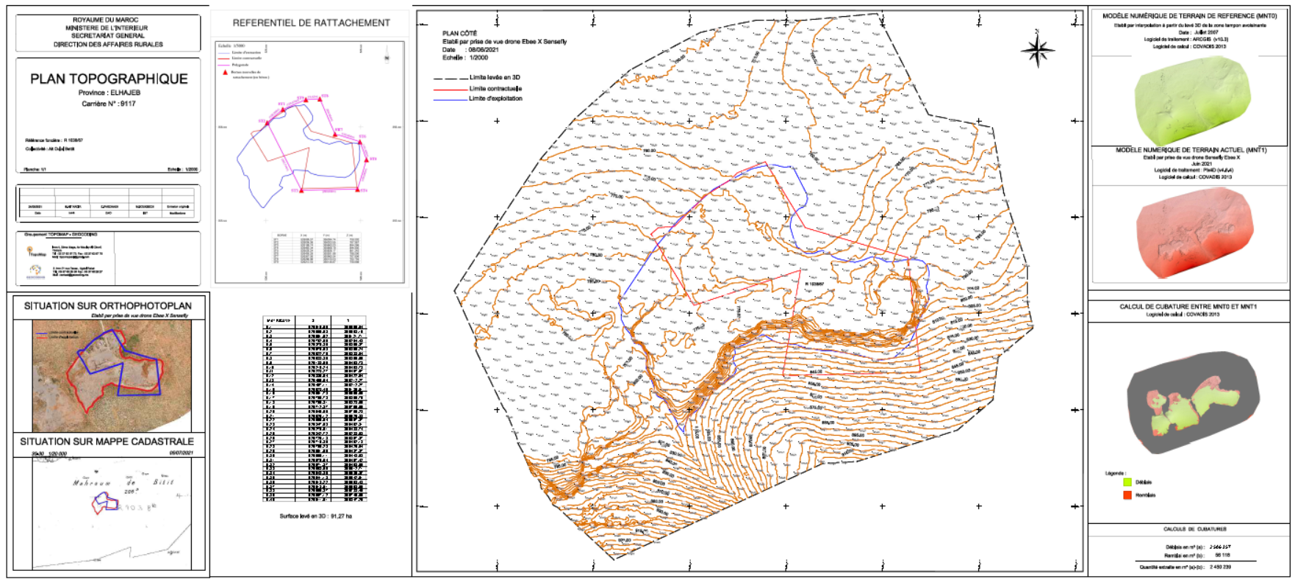
A Family Business Success Story
Quarries reconstitution results
Innovating for the Special Project
Research Project:
Research project management to reconstruct quarries with minimal error
TopoBot Quarries :
Mobile solution for quarry data management
3D drone measurements for 350 quarries
Automated topographic plan generation
AutoCAD extension for automated drawing based on Moroccan cadastral standards
Automatic report generation for each quarry
Centralized real-time database
Supervising drone data acquisition in the field
TopoBot Quarries Desktop
fully automated drawing with TopoBot

Slide 12
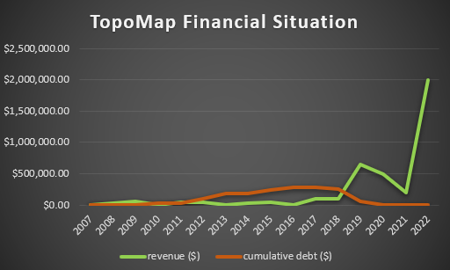
A Family Business Success Story
Achievements from the Special Project
Error/incomplete deliverable rate reduced from 80-90% to 1-2%
Plan generation time decreased from 7 hours to 5 minutes
3x increase in revenue compared to the last 2 years
Revenue reached $2 million

Slide 13
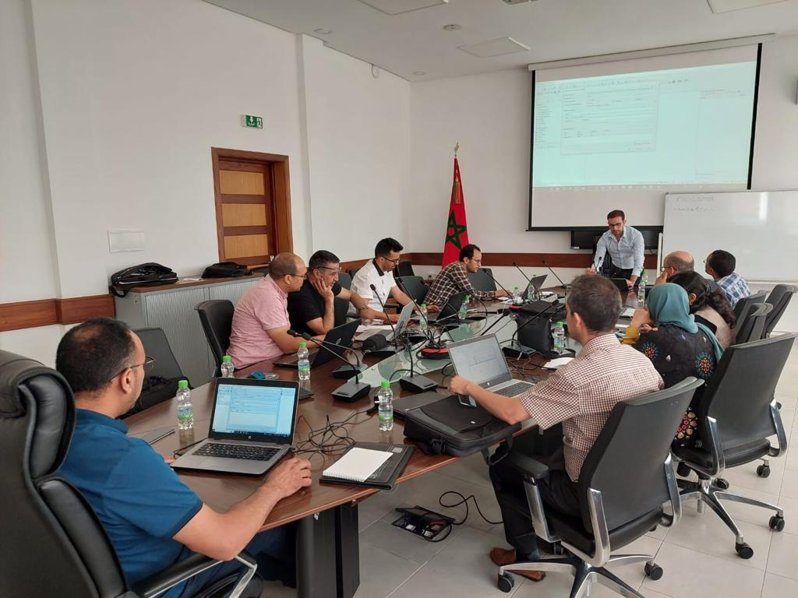
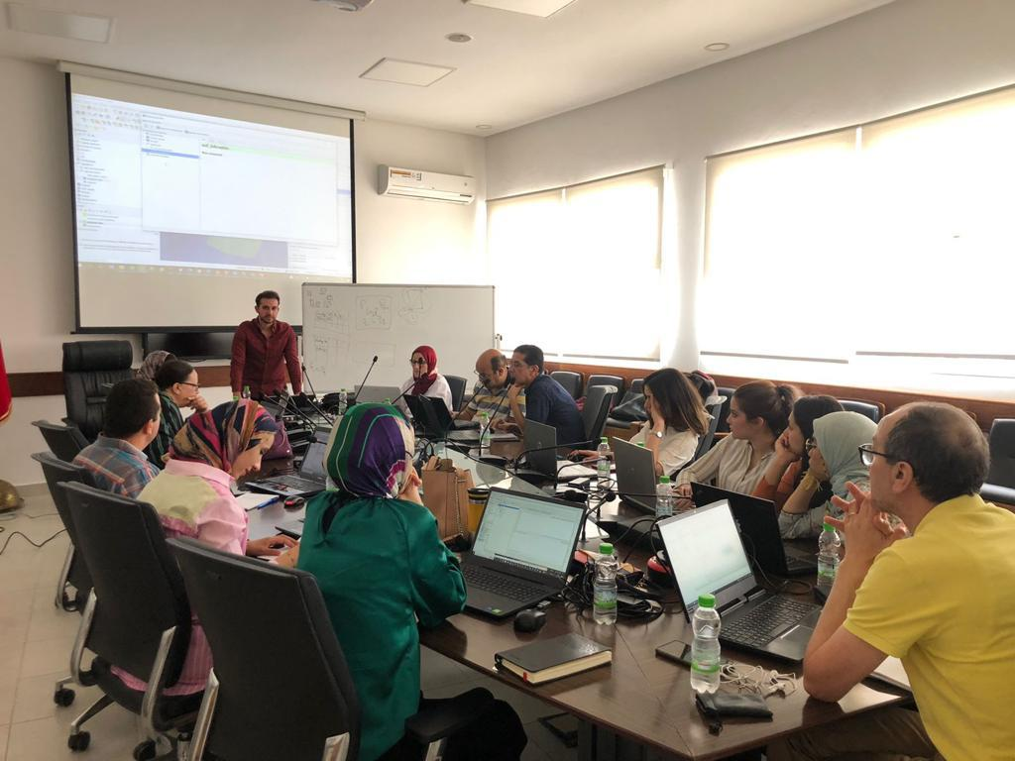

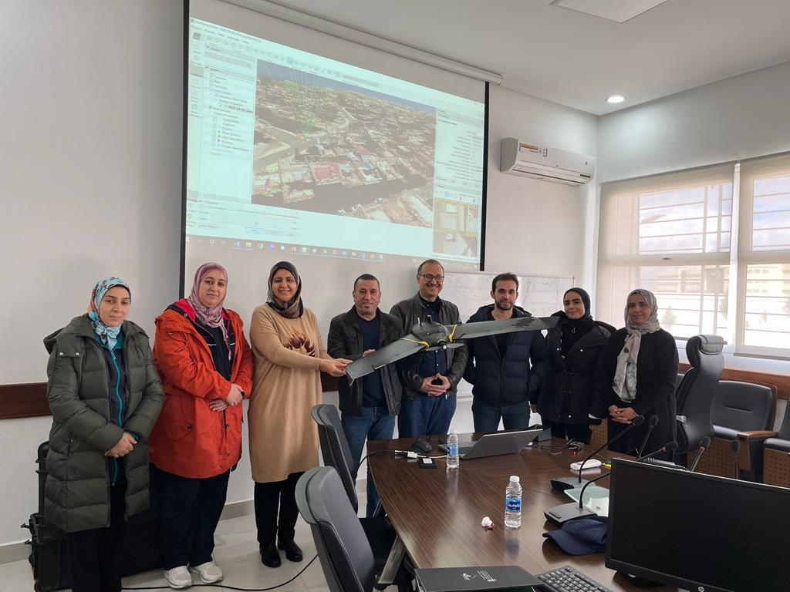
A Family Business Success Story
Expanding Horizons
Created a new company “Handle IT Services” offering IT consulting services
Providing personalized training in spatial data analysis and process automation as a sole expert
Fostering relationships with partners and expanding B2B networks

Slide 14
Conclusion
My passion for technology, education, and dedication to the family business transformed Topomap into a market leader, and led to the creation of a new consulting company Proven ability to innovate and deliver results in challenging circumstances while expanding B2B networks

